Slide 1
Data Levels of Measurement

Slide 2
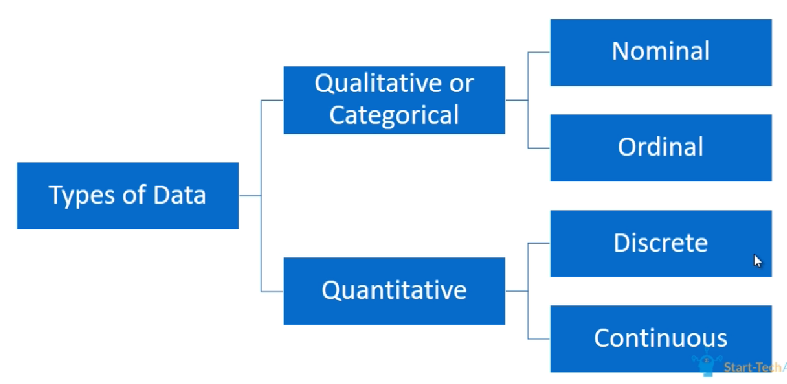

Slide 3
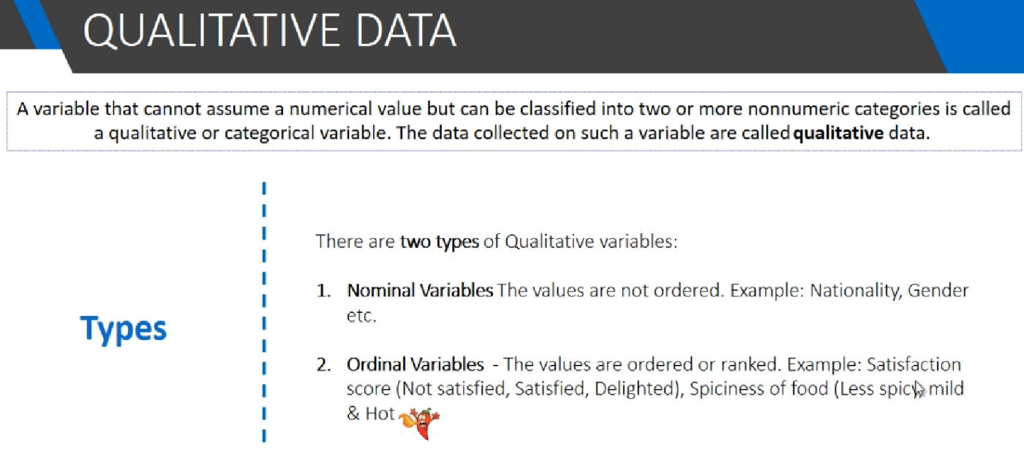

Slide 4


Examples: Nominal Scale
Examples: Ordinal Scale

Slide 5
